Slide 1

Legal Notes for Registrars
Atty. Joseph Noel M. Estrada

Slide 2

Function of a REGISTRAR
The Registrar is responsible for the supervision and management of all administrative and operational functions of the Office of the Registrar.

Slide 3


Registrar: The Guardian
The Registrar ensures the integrity, accuracy, and security of all academic records of current and former students; facilitate effective student registration and enrollment; builds secure student data files and sets policy and procedure for their responsible use;

Slide 4

Registrar: The Custodian
Maintains up-to-date course schedules, catalogs, final examination schedules; and manages efficient use of classrooms. The Registrar supervises the processes for the articulation of transfer credits, graduation and certification of baccalaureate and associate degrees, enrollment and degree verification, production of official transcripts, diplomas, and commencement ceremonies.

Slide 5

Registrar: The Chair
The Registrar counsels and advises students, faculty, and staff on academic matters. Additionally, the Registrar chairs the Registration, Credits, and Graduation Council, Calendar Committee, Registration Committee, Grade Appeal Committee for undergraduate students, Commencement Committee, Residence Rule/Retention Appeal Committee; and is a member of various other Councils and Committees in the School.

Slide 6

Nature of Employment

Slide 7

Registrar = Academic Personnel
"Teaching or academic staff," or all persons engaged in actual teaching and/or research assignments, either on full-time or part-time basis, in all levels of the educational system.
"Academic non-teaching personnel," or those persons holding some academic qualifications and performing academic functions directly supportive of teaching, such as registrars, librarians, research assistants, research aides, and similar staff.
Education Act of 1982
"School administrators," or all persons occupying policy implementing positions having to do with the functions of the school in all levels.

Slide 8

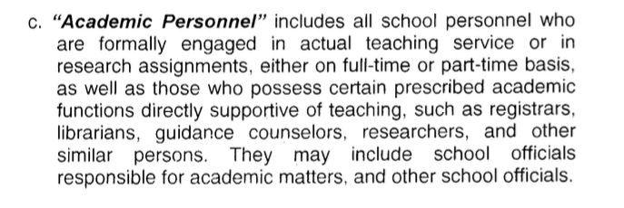
DepEd 88, s. 2010 (MRPSBE):

Slide 9

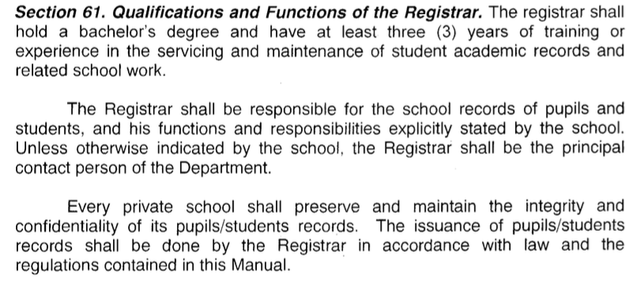
Who are Qualified?

Slide 10
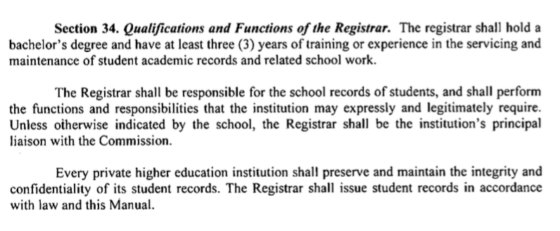
CMO 40, s. 2008 (MORPHEI)

Slide 11

What is the implication?
PROBATIONARY EMPLOYEES
The current versions of MOPRHEI and the MRPSBE expressly provide that the three-year probationary period shall be applicable to full-time teaching personnel. And the six-month probation period to non-academic personnel.

Slide 12

Thus, both periods do not squarely apply to academic non-teaching personnel like the Registrar.
However, given the peculiar nature and highly technical academic function of the Registrar, it is advanced that the school as a matter of policy may adopt a longer period of probation, usually following the maximum 3-year period for teachers.
However, more often than not, Registrar position is assumed by teachers and faculty who have long exemplified their expertise in the school as a full-time regular teacher.

Slide 13

MAGIS, et. al. vs. Manalo
6 month probationary period, however, does not apply to all classes of occupations.
For academic personnel in private schools, colleges and universities, probationary employment is governed by Section 92 of the 1992 Manual of Regulations for Private Schools which reads:
Section 92. Probationary Period. Subject in all instances to compliance with the Department and school requirements, the probationary period for academic personnel shall not be more than three (3) consecutive years of satisfactory service for those in the elementary and secondary levels, x x x

Slide 14
MAGIS, et. al. vs. Manalo
This was supplemented by DOLE-DECS-CHED-TESDA Order No. 1 dated February 7, 1996, which provides that the probationary period for academic personnel shall not be more than three (3) consecutive school years of satisfactory service for those in the elementary and secondary levels By this supplement, it is made clear that the period of probation for academic personnel shall be counted in terms of school years, and not calendar years. Then, Section 4.m(4)[c] of the Manual delineates the coverage of Section 92, by defining the term academic personnel to include:

Slide 15

(A)ll school personnel who are formally engaged in actual teaching service or in research assignments, either on full-time or part-time basis; as well as those who possess certain prescribed academic functions directly supportive of teaching, such as registrars, librarians, guidance counselors, researchers, and other similar persons. They include school officials responsible for academic matters, and may include other school officials.
Photo source: our.upd.edu.ph

Slide 16

As to grounds for termination, the provisions of the Manuals and the School policy for teachers and academic personnel shall apply suppletory to the Labor Code provisions on termination.

Slide 17

The Registrar and the Students

Slide 18

Student’s Rights
Sec. 9. Right of Students in School. — In addition to other rights, and subject to the limitation prescribed by law and regulations, and student and pupils in all schools shall enjoy the following rights:
4. The right of access to his own school records, the confidentiality of which the school shall maintain and preserve.
5. The right to the issuance of official certificates, diplomas, transcript of records, grades, transfer credentials and other similar documents within thirty days from request.

Slide 19

Rights of Parents
Sec. 8. Rights of Parents. — In addition to other rights under existing laws, all parents who have children enrolled in a school have the following rights.
2. The right to access to any official record directly relating to the children who are under their parental responsibility.

Slide 20

Enrollment of Students
ATENEO V. CAPULONG
Every student has the right to enroll in a private school upon meeting its specific standards and reasonable regulations as well as the requirements prescribed by law or regulation. Except in cases of academic delinquency and/or violation of disciplinary regulations, the student shall be presumed qualified for enrolment for the entire period he is expected to complete his course without prejudice to his right to transfer as provided for in this Manual. (Sec. 117)

Slide 21

Case study: STRAINED RELATIONS
“Lastly, where relations between parents and students on the one hand, and teachers and administrators upon the other hand, have deteriorated to the level here exhibited, a private school may, in the interest of the rest of the student body and of the faculty and management as a whole, and of the children of the parents affected, require the affected children to be enrolled elsewhere. The maintenance of a morally conducive and orderly educational environment will be seriously imperiled if, under the circumstances of this case, the [School] is forced to admit petitioners’ children and to reintegrate them to the student body. It may be even be argued that petitioners' children have been innocent victims in a deplorable confrontation between some parents and respondent School, but the situation here finds some analogy in labor cases where, because of pre-existing and supervening strained relations, reinstatement is not always a feasible solution.”
(Yap Chin Fah v. Court of Appeals, G.R. No. 90063)

Slide 22

San Sebastian College v. Reynaldo Borja y Torres

Slide 23
San Sebastian College v. Reynaldo Borja y Torres
Reynaldo was enrolled in SSC’s institution as second year high school (student) day session, in the school year 1979-80;
At the end of the school year he failed in 3 academic disciplines—Mathematics, Pilipino and Practical Arts. His failure in the last subject was reconsidered, to make him pass subject to conditions.
The conditions were for Reynaldo to be allowed to take summer at NU but so that he can be eligible to enroll to another school for Third Year.
Reynaldo took the 1980 summer classes at the National University in the two subjects he failed and obtained passing grades thereat;
Reynaldo’s father tried to enroll the latter for the school year 1980-1981 but failed because the SBC refused and still refuses to admit him.

Slide 24

According to Reynaldo’s father, he had an agreement with the School that Reynaldo will be allowed to take summer at different school and be allowed to enroll in SSC.
But SSC denied such agreement in view of their policy.

Slide 25

Whether or not the SSC is liable in damages for its refusal to admit Reynaldo as a regular third year high school student.
The dropping of the private respondent from the petitioner's roll of students was not done precipitately. Private respondent's grades were of his own making. He failed in Practical Arts because he did not submit a required project. His teacher saw fit to fail him for his non-compliance. At the end of the last grading period, the Committee on Admission deliberated on the school standing of students who incurred failures in three academic subjects and among them was the private respondent. With regard to the latter, the Committee resolved that he be made to transfer to another school in line with the petitioner's policy.

Slide 26
The courts simply do not have the competence nor inclination to constitute themselves as Admission Committees of the universities and institutions of higher learning and to substitute their judgment for that of the regularly constituted Admission Committees of such educational institutions. Were the courts to do so, they would conceivably be swamped with petitions for admission from the thousands refused admission every year, and next the thousands who flunked and were dropped would also be petitioning the courts for a judicial review of their grades.

Slide 27
In refusing admission to Reynaldo despite his having passed his summer courses, petitioner was merely consistent in its policy not to admit students who incurred three academic failures unless they repeat the whole year. The fact that one subject was reconsidered or that failed subjects were successfully hurdled during summer would not entitle Reynaldo to an exception there being no evidence to show that other students with similar circumstances were given that privilege. Besides, under its rules on promotion, SSC has made clear that only students who passed their regular load will be promoted to the next higher level

Slide 28
True, an institution of learning has a contractual obligation to afford its students a fair opportunity to complete the course they seek to pursue. However, when a student . . . fails to maintain the required academic standard, he forfeits his contractual right; and the court should not review the discretion of university authorities.

Slide 29
Registration (Sec. 119), MRPSBE:
When a student registers in a school, it is understood that he is enrolling for the entire school year for elementary and secondary courses.
No pupil or student shall be officially enrolled unless he presents the proper school credentials on or before the end of the enrollment period for the school term.
Deemed officially enrolled – After a student has submitted his appropriate admission or transfer credentials, has made an initial payment of his school fees which has been accepted by the school, and has been authorized to attend classes in the school.

Slide 30

Right to Enroll until graduation
(Sec. 120):
Admission to any private school is open to all pupils and students who meet its specific standards, requirements and regulations as expressed in printed publications or other written materials. Except in cases of (1) academic delinquency, (2) violation of school rules and regulations, (3) the closure of a program or course of study by the school, or (4) the closure of the school itself x x x

Slide 31

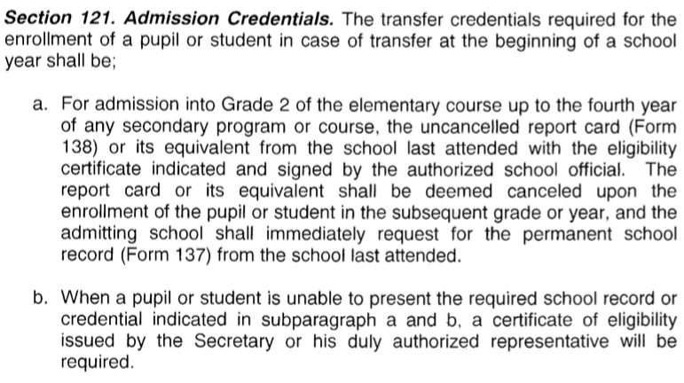

Slide 32

Transfer of Credentials (sec 127)
A pupil or student enrolled in one school is entitled to transfer to another school provided he has no unsettled obligations with the school he was enrolled in.

Slide 33

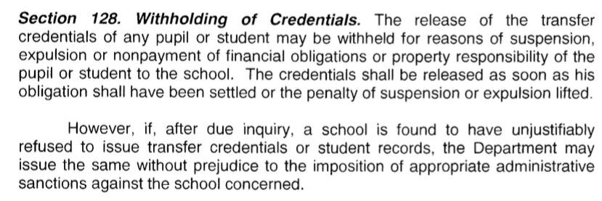

Slide 34
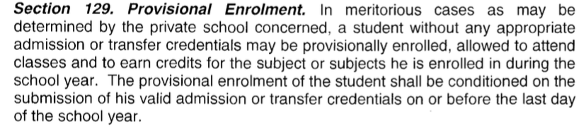

Slide 35
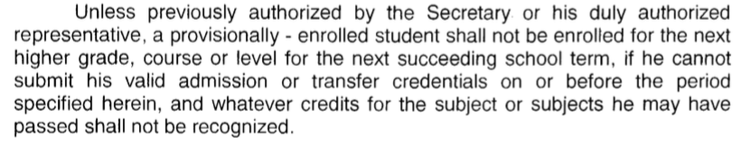

Slide 36
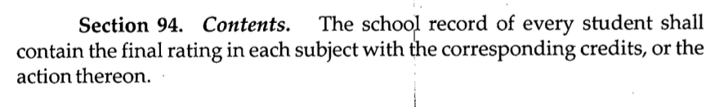
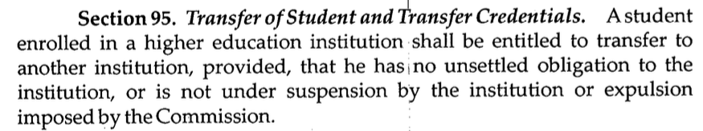
MANUAL FOR REGULATION FOR PRIVATE HIGHER EDUCATION

Slide 37
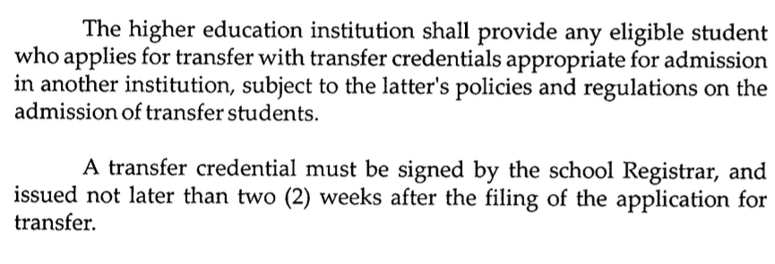

Slide 38
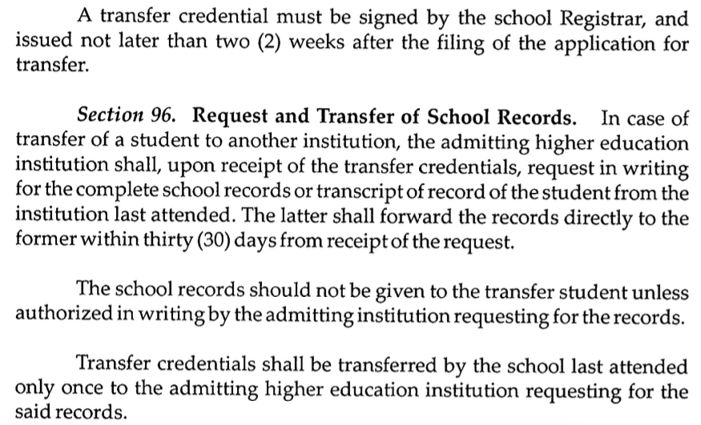

Slide 39
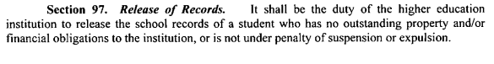
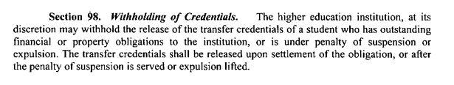

Slide 40
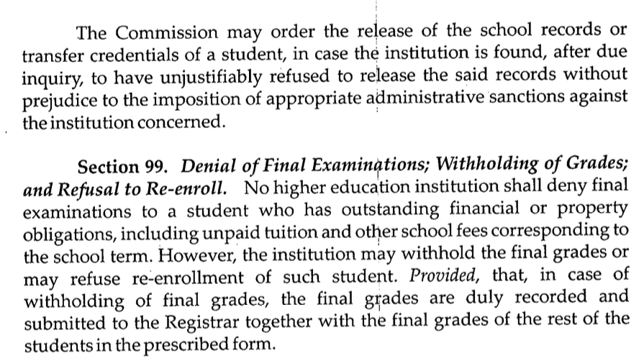

Slide 41
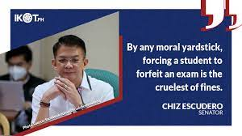

Slide 42
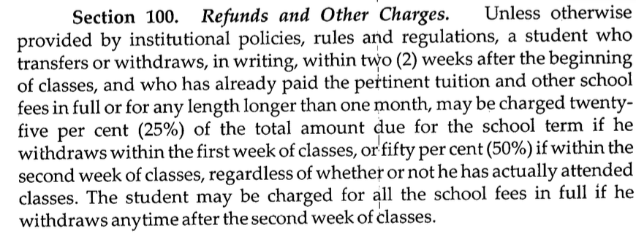

Slide 43

Regino v. Pangasinan Colleges of Science and Technology
The terms of the school-student contract are defined at the moment of its inception — upon enrolment of the student. Standards of academic performance and the code of behavior and discipline are usually set forth in manuals distributed to new students at the start of every school year. Further, schools inform prospective enrollees the amount of fees and the terms of payment.
In practice, students are normally required to make a down payment upon enrollment, with the balance to be paid before every preliminary, midterm and final examination. Their failure to pay their financial obligation is regarded as a valid ground for the school to deny them the opportunity to take these examinations.

Slide 44

Education is not a measurable commodity. It is not possible to determine who is "better educated" than another. Nevertheless, a student's grades are an accepted approximation of what would otherwise be an intangible product of countless hours of study. The importance of grades cannot be discounted in a setting where education is generally the gate pass to employment opportunities and better life; such grades are often the means by which a prospective employer measures whether a job applicant has acquired the necessary tools or skills for a particular profession or trade.

Slide 45
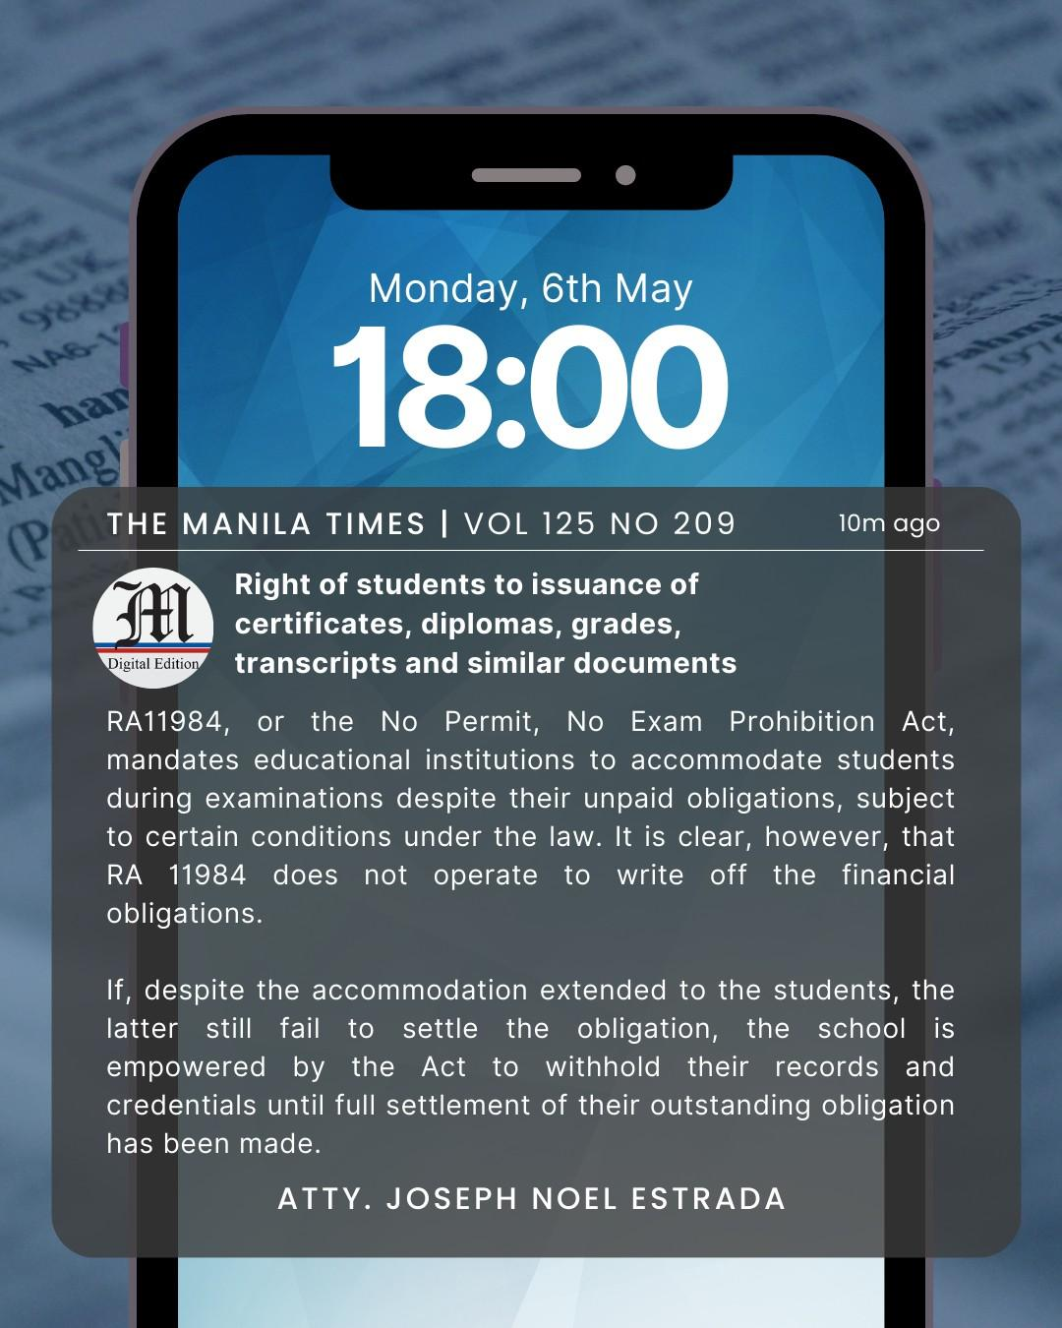

Slide 46

UST, et. al. v. Danes Sanchez
This case began with a Complaint for Damages filed by Danes B. Sanchez against the University of Santo Tomas (UST) and its Board of Directors, the Dean and the Assistant Dean of the UST College of Nursing, and the University Registrar for their alleged unjustified refusal to release the respondents’ Transcript of Records (ToR).
Photo source: Flickr.com

Slide 47

In his Complaint, Sanchez alleged that he graduated from UST on April 2, 2002 with a Bachelor’s Degree of Science in Nursing.
He was included in the list of candidates for graduation and attended graduation ceremonies.
On April 18, 2002, Sanchez sought to secure a copy of his ToR with the UST Registrar’s Office, paid the required fees, but was only given a Certificate of Graduation by the Registrar.

Slide 48

Despite repeated attempts by Sanchez to secure a copy of his ToR, and submission of his class cards as proof of his enrolment, UST refused to release his records, making it impossible for him to take the nursing board examinations, and depriving him of the opportunity to make a living.
The respondent prayed that the RTC order UST to release his ToR and hold UST liable for actual, moral, and exemplary damages, attorneys fees, and the costs of suit.

Slide 49

UST:
They claimed that they refused to release Sanchez’ ToR because he was not a registered student, since he had not been enrolled in the university for the last three semesters.
They claimed that the respondents graduation, attendance in classes, and taking/passing of examinations were immaterial because he ceased to be a student when he failed to enroll during the second semester of school year 2000-2001.

Slide 50

CHED’s power
- cannot award damages
Was respondent enrolled or not?
Was his degree obtained fraudulently?
If so, why was he permitted by the petitioners to graduate? Was there fault or negligence on the part of any of the parties? Clearly, these are factual matters which can be best ventilated in a full-blown proceeding before the trial court.

Slide 51

Can a University revoke the degree conferred?

Slide 52

UP Board of Regents v. Court of Appeals
Petitioner graduated from the U.P. with a doctorate degree in Anthropology.
After graduation, the contact between U.P. and petitioner ceased.
After a year, UP discovered that Petitioner’s graduation was a mistake because it was obtained through FRAUD.
Petitioner contends that since he already graduated, he is no longer within the ambit of the disciplinary powers of the U.P, thus administrative sanctions such as suspension cannot be effected.
Photo source: University of the Philippines Diliman

Slide 53
UP Board of Regents v. Court of Appeals
Where it is shown that the conferment of an honor or distinction was obtained through fraud, a university has the right to revoke or withdraw the honor or distinction it has thus conferred.
This freedom of a university does not terminate upon the graduation of a student, as the Court of Appeals held. For it is precisely the graduation of such a student that is in question.
Photo source: University of the Philippines Diliman

Slide 54

An institution of higher learning cannot be powerless if it discovers that an academic degree it has conferred is not rightfully deserved. Nothing can be more objectionable than bestowing a university’s highest academic degree upon an individual who has obtained the same through fraud or deceit. The pursuit of academic excellence is the university’s concern. It should be empowered, as an act of self-defense, to take measures to protect itself from serious threats to its integrity.
Photo source: Philippine Star

Slide 55

University of San Carlos v.
Court of Appeals and Jennifer Lee
The principal issue raised in this petition is whether or not mandamus is the proper remedy to compel a university to confer a degree with honors.
The secondary question is whether or not the refusal of that university to confer honors would constitute bad faith so as to make it liable for damages.

Slide 56

A university may not be compelled by mandamus to grant graduation honors to any student who, according to the university's standards, rules and regulations, does not qualify for such honors;

Slide 57

The School cannot be faulted for refusing to vest the honors demanded of them by the private respondent. One failure would have been sufficient to disqualify her but she had one incomplete and two failures. Her only change was to reverse her failing grades. This she accomplished thru the back door.
Nevertheless, even if she succeeded in removing her failing grades, it was still within the sound discretion of the petitioners to determine whether private respondent was entitled to graduate with honors. The Court finds that petitioners did not commit a grave abuse of discretion in denying the honors sought by private respondent under the circumstances. Indeed, the aforesaid change of grades did not automatically entitle her to the award of honors.

Slide 58
TECHNOLOGICAL INSTITUTE OF THE PHILIPPINES TEACHERS and EMPLOYEES ORGANIZATION (TIPTEO), et al.,vs. TIP
Salon admitted that she changed the grade of Manalo from one of failure (5.0) to dropped (6.0) at the behest of a colleague, the mother of Manalo, to save the son from being harmed by his father for his failing grade. Salon thought she was doing the family of Manalo a favor, but her act produced the opposite result because the father himself lodged a complaint against her for grade tampering as suspected all along, the father was not satisfied with a grade of 6.0 for his son.

Slide 59

Salon's guilt is not erased or mitigated by the fact that she meant well, or that she tried to rectify her indiscretion after realizing that she violated the grading system of the school.

Slide 60

It goes beyond a school violation; it is a violation against the Manual of Regulation for Private Schools whose Section 79 provides:
Sec. 79. Basis for Grading. The final grade or rating given to a pupil or student in a subject should be based on his scholastic record. Any addition or diminution to the grade x x x shall not be allowed.

Slide 61
Colegio De San Juan de Letran vs. Isidra Dela Rosa Meris, G.R. No. 178837 September 1, 2014
While respondent’s motive for increasing the grades of certain students in the Clean Records was not known or could have been noble, the fact is, unauthorized and improper alterations were effected in the official records of petitioner, a clear violation of petitioner’s Elementary Faculty Manual as well as the Private School Manual adhered to by petitioners and its faculties. Respondent is deemed to have exercised an unreasonable degree of discretion in failing to provide a concrete basis for increasing the grades of certain students. For this, respondent should be made to face the consequences of her actions. To tolerate such conduct will, indeed, undermine the integrity of petitioner’s grading system, and its standing as an academic institution as well.

Slide 62

“Snopake” Doctrine
Negligence in keeping school or student records, or tampering with or falsification of the same can neither be cured nor corrected by compassion towards the students, because the means does not justify the end.

Slide 63
Colegio San Agustin-Bacolod v. Montaño, G.R. No. 212333, [March 28, 2022])
The Registrar committed serious misconduct in allowing ineligible students to march. She violated an established school policy as espoused in a memorandum issued by the university which states that "[n]o student will be allowed to march for graduation unless he/she has fully complied with all the academic requirements of his/her course."
Circumstances show that the registrar’s act is clearly a conscious and willful transgression of the university's established rule regarding graduation rites. It is not a mere error in judgment or an inadvertent act. The rule is very clear that students who did not comply with all the academic requirements shall not be allowed to march in the graduation rites. The registrar was consistent in reiterating this rule; she even reminded the deans to observe the policy. Yet, she herself made a conscious decision or choice to violate the established rule that she insisted to be followed in allowing the ineligible students to march.

Slide 64

The Court is not convinced of the excuses that respondent posits. The excuse that she merely followed the practice of allowing some ineligible students to march as observed by previous registrars is unacceptable. First, the existence of that practice is not proven. Respondent merely alleged that there is such practice that the previous registrars follow without showing proof thereof. Second, whether following a previous practice or not, respondent nonetheless committed a violation of a school rule. The practice itself, assuming that it is existing, is obviously violative of the school policy; respondent should not have continued performing it. In occupying a high position in in the College, she should have been a bastion of strict compliance with rules and policies. She should have initiated changes to counter that previous practice and the impression of leniency it brings.

Slide 65
Further, the letters signed by the students and their parents and indorsed by the deans do not absolve respondent from misconduct. She should not have acted by herself in allowing those ineligible students to march. Respondent should have raised the matter to the proper authorities in charge of determining who shall graduate and participate in the rites.
Likewise, the non-issuance of CHED special order numbers does not erase, nor even mitigate, respondent's commission of a violation. The fact that she allowed the ineligible students to march — to reiterate, a transgression of the rule — remains whether special order numbers were issued or not.

Slide 66

Considering these, the Court holds that respondent committed serious misconduct that constitutes just cause for valid dismissal from employment.
The Court also finds that respondent's act constitutes a breach of trust and confidence.
There is no dispute that respondent as school registrar occupied a position of trust. She is in possession and custody of student records, which are vital for any educational institution. The Court holds that respondent's act justifies loss of trust and confidence. Respondent's conscious decision of allowing the ineligible students to march shows her willfulness to transgress the established rule. This willful transgression of a rule indeed results to the loss of the trust and confidence the College has reposed on her.
In this regard, the Court adds that the length of time (30 years) respondent was employed with the College cannot outweigh the seriousness of the violation she has committed, even if this is the first time she transgressed a rule. This is because once trust and confidence are betrayed, it will be difficult to restore the smooth relationship that had once been existing.
Photo source: our.upd.edu.ph

Slide 67

Atty. Joseph Noel M. Estrada

